Slide 1

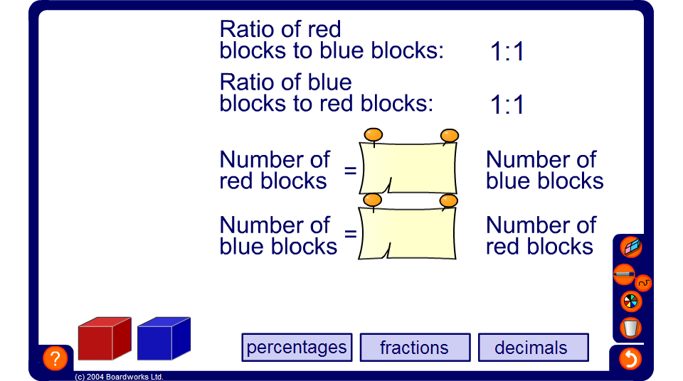


Stacking blocks
Notes:
Use the activity to introduce the concept of ratio and ratio notation. The activity also shows ratios as fraction, decimal and percentage multipliers.
This activity can also be used to develop the concept of ratio throughout Key Stage 3 to develop pupils’ concept of multiplicative relationships.
We use ratio to compare the size of one quantity to the size of another.
Stress that in the case of these blocks we can compare the number of red blocks to the number of blue blocks.
Show one red block and one blue block.
The ratio of red blocks to blue blocks is 1 : 1. For 1 red block there is 1 blue block. We write this ratio as 1 : 1.
Reveal this ratio on the board. Stress the use of the ‘:’ symbol used in ratio notation.
Let’s see what happens if we double the number of blue blocks and red blocks.
Show two red blocks and two blue blocks.
Stress that there is still one blue block for every red block. The ratio 2 : 2 is the same as the ratio 1 : 1.
Ask pupils to tell you other ratios that are equivalent to 1 : 1. Demonstrate these using the blocks if necessary.
Next, show one red block and two blue blocks. Ask pupils to give statements comparing the number of red blocks to the number of blue blocks.
For example, ‘there is half the number of red blocks as blue blocks’, ‘the ratio of red blocks to blue blocks is 1 : 2’, ‘there are two times as many blue blocks as red blocks’, ‘a third of the blocks are red’.
This last statement refers to the proportion of the blocks that are red. Stress that a proportion compares the size of a part to the whole whereas a ratio compares the sizes of parts to each other.
Use the blocks to demonstrate ratios equivalent to 1 : 2 and repeat for other ratios.

